Slide 1
Research on Super Resolution
Alex Nishio

Slide 2
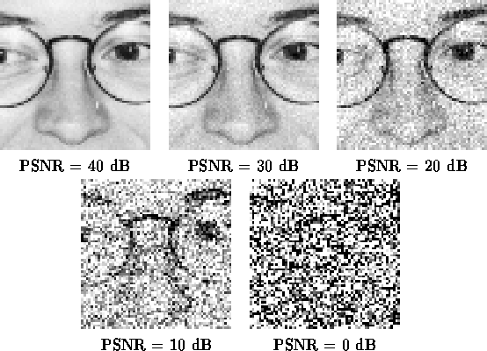
PSNR (peak signal to noise ratio)
Note from Future Self
PSNR is an outdated metric, making this slide redundant
Example:
SUPIR has a lower PSNR value but the output quality is very good
See Page 6 in SUPIR paper

Slide 3
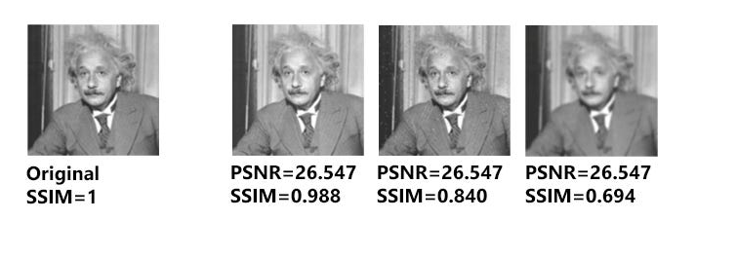
SSIM (structure similarity index measure)
Note from Future Self
Same as PSNR in Slide 2, SSIM is also redundant for the same reasons as evident in the SUPIR model

Slide 4
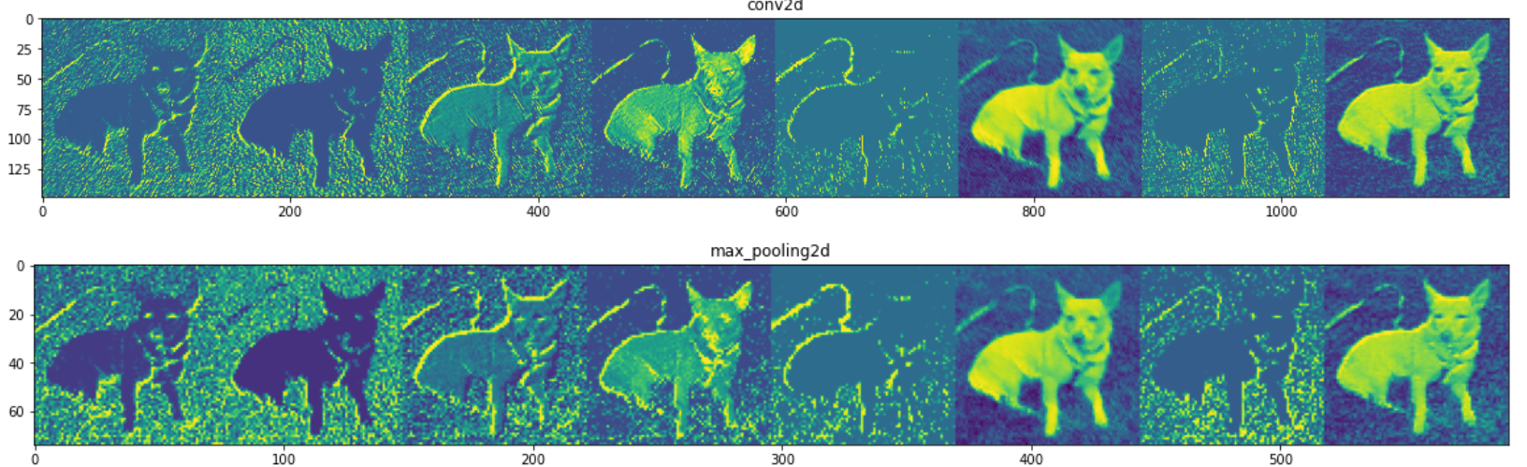
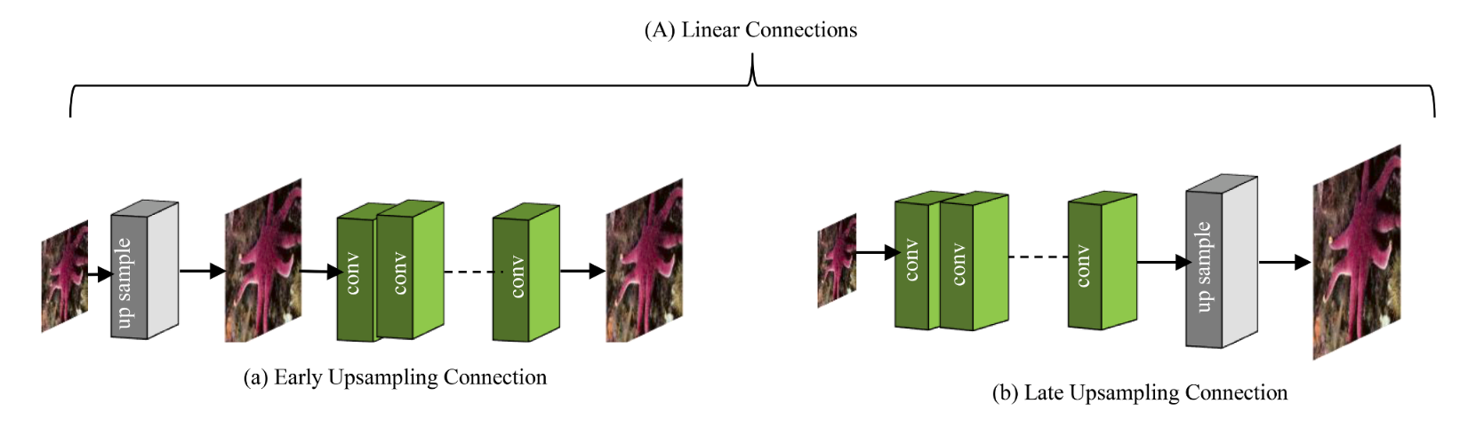
Different Methods
Convolutional Neural Networks (CNNS)
First Upsample
Learn Hierarchical Representations of Features
Produce Feature Map
Transform Feature Map to High Dimension Vector
Combine Feature Map

Slide 5
Alternative Methods
Transformer Based Methods
Very Robust from Exploding
Useful even when data is scarce
Grown In Popularity
AdaFormer

Slide 6

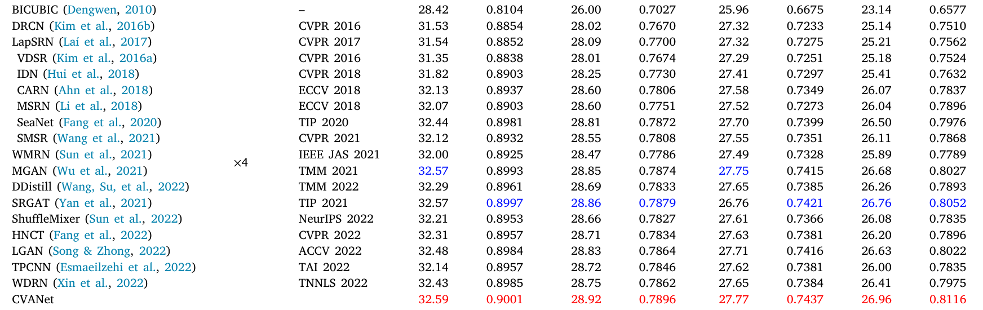
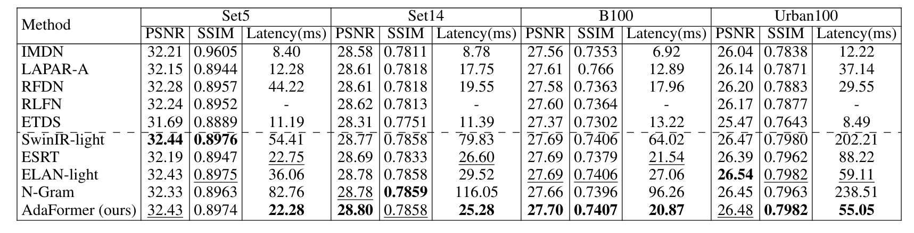
Comparison In Results (4x)
CNN (CVANet)
2. Transformer (AdaFormer)

Slide 7
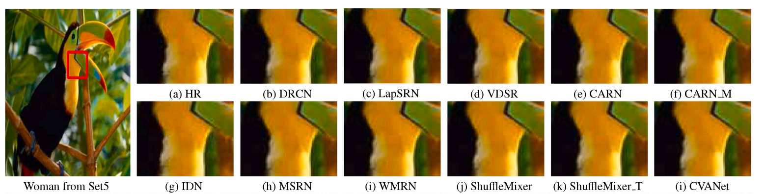
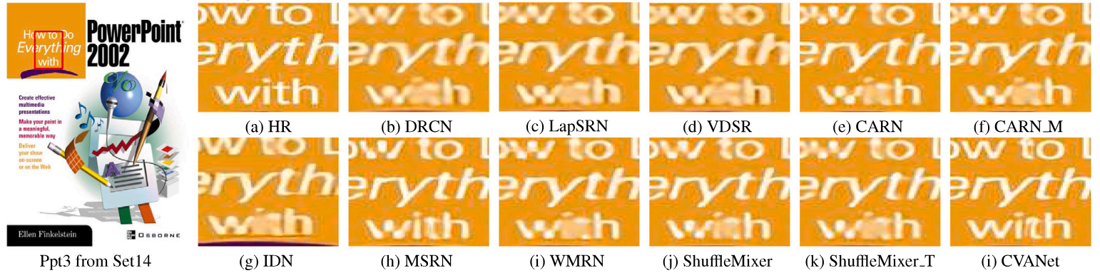
Results (Images)
CNN (CVANet)

Slide 8
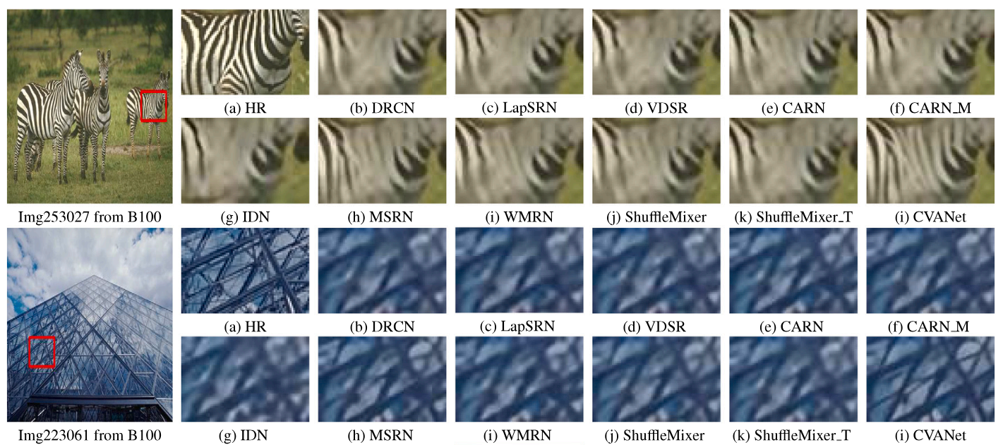
Results (Images) (cont)
CNN (CVANet) (cont)

Slide 9
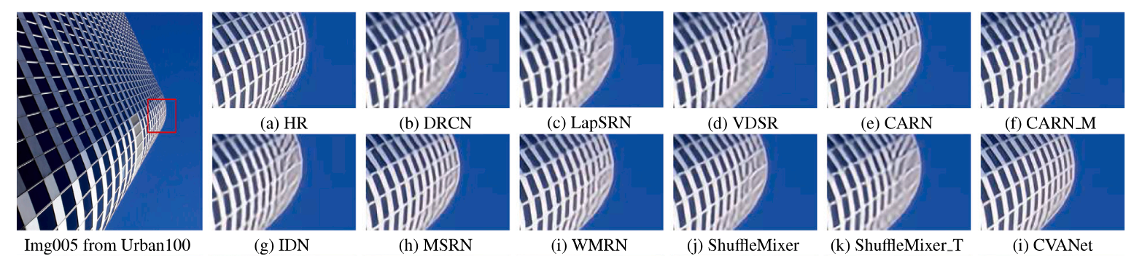
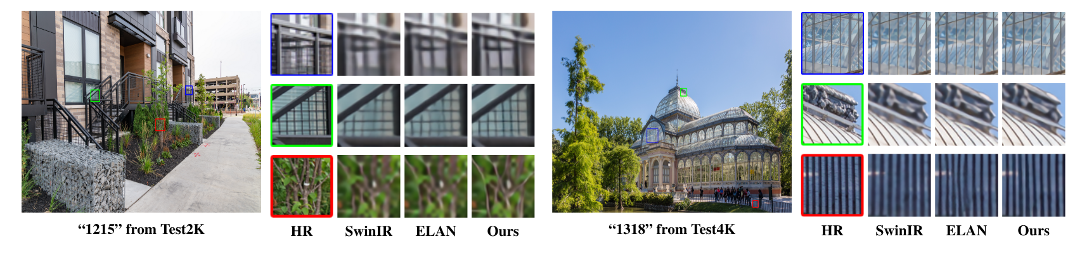
Results (Images) (cont)
CNN (CVANet) (cont)
2. Transformer (AdaFormer)

Slide 10
General Results
Results do not look extremely promising
Will need to perform more research in order to find a model that can truly enhance image quality

